Slide 1




Chongqing University of Technology
ATAI
Advanced Technique of Artificial Intelligence
Chongqing University of Technology
Text Level Graph Networks for Text Classification
Huang L, Ma D, Li S, et al(EMNLP-2019)
Reported by Ling Zhu

Slide 2

Chongqing University of Technology
ATAI
Advanced Technique of Artificial Intelligence
Chongqing University of Technology
1. Motivation
2. Method
3. Experiments
4. Conclusion

Slide 3
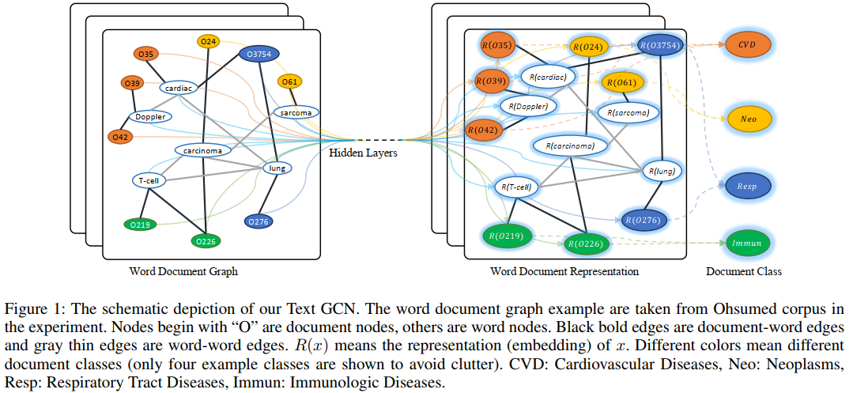
Motivation

Slide 4


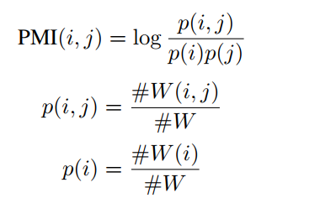
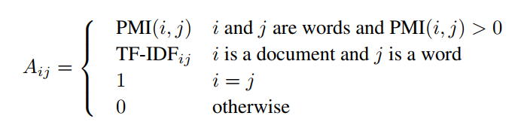
Motivation

Slide 5
Motivation
Text GCN disadvantage
1. build graph consume large memory and its weight is
fixed,limits the expression ability of edges
2. cannot conduct the online test

Slide 6
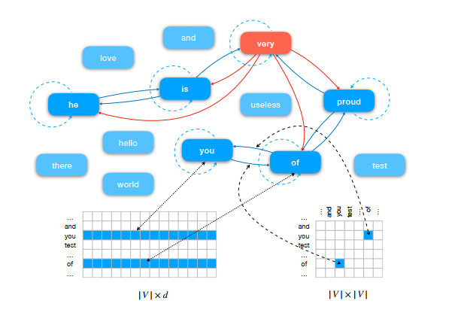
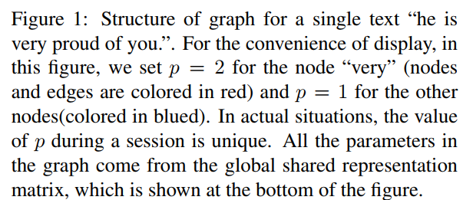
Approach

Slide 7




Approach
Build graph
$M_{n}∈R^{d}$ is the messages that node n receives from its neighbors.
max is a reduction function which combines the maximum values on each dimension to form a new vector as an output.
$N_{n}^{p}$ denotes nodes that represent the nearest $p$ words of $n$ in the original text.
$e_{an}$ is the edge weight from node a to node n and it updated during training.
$r_{n}∈R^{d}$ denotes the former representation of node n .
${\text{η}}_{n}∈R^{1}$ is a trainable variable for node n that indicates how much information of $r_{n}$ should be kept .
$r_{n}^{′}$ denotes the updated representation of node n.
Message Passing Mechanism

Slide 8
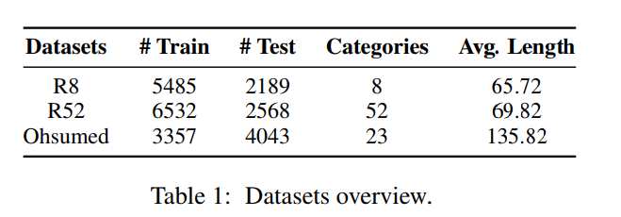
Experiments

Slide 9
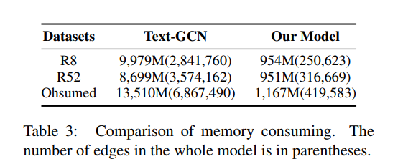
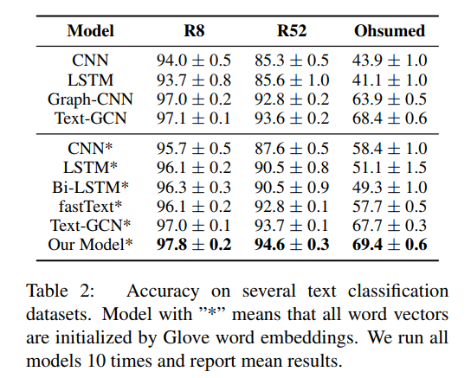
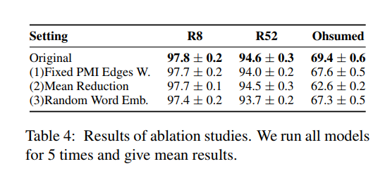
Experiments

Slide 10
Conclusion
1.proposed a new graph based text classification model, which uses text level graphs instead of a single graph for the whole corpus
2.Experimental results show that our model achieves
state-of-the-art performance and has a significant
advantage in memory consumption.

Slide 11
Thanks

